Slide 1
Amdocs Onboarding Training
Final project presentation
Project name -: E-Learning project
By -: Yamini Singh

Slide 2
Tools & Technologies Used
Frontend -: HTML, Bootstrap, Javascript.
Backend -: PHP.
Database -: MySql.
Editor -: VS code editor.

Slide 3
Project Modules
Complete project is divided into three different Modules and those are:
frontend
backend
database
Frontend and backend are loosely coupled i.e both are independent of each other.
Communication between the frontend and backend is taking place with the help of API’s.

Slide 4
Frontend
Frontend layer is the user interface layer from which the user can interact with the server and do the required function.
For this demo frontend is running on the local server provided by the vs code editor itself.
Frontend folder contains two folders and those are HTML,JS. HTML folder contains all the html pages that is displayed to the user.

Slide 5
Backend
Backend contains the mysql server which run the server at localhost port 3306.
Mysql database has been connected with backend using all the credentials.

Slide 6
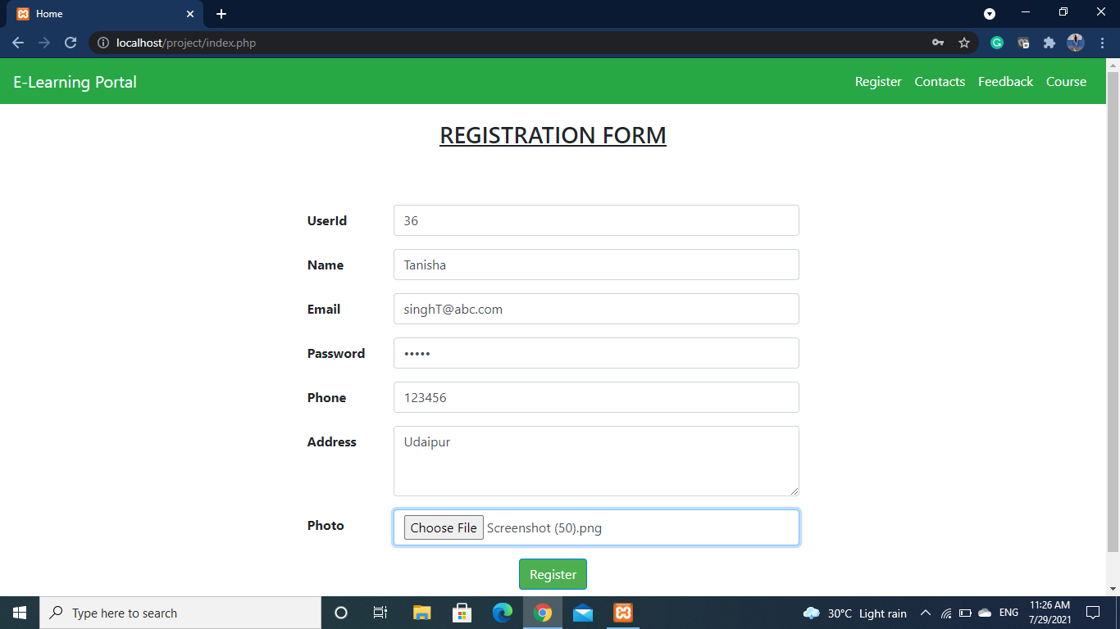
Screenshots

Slide 7
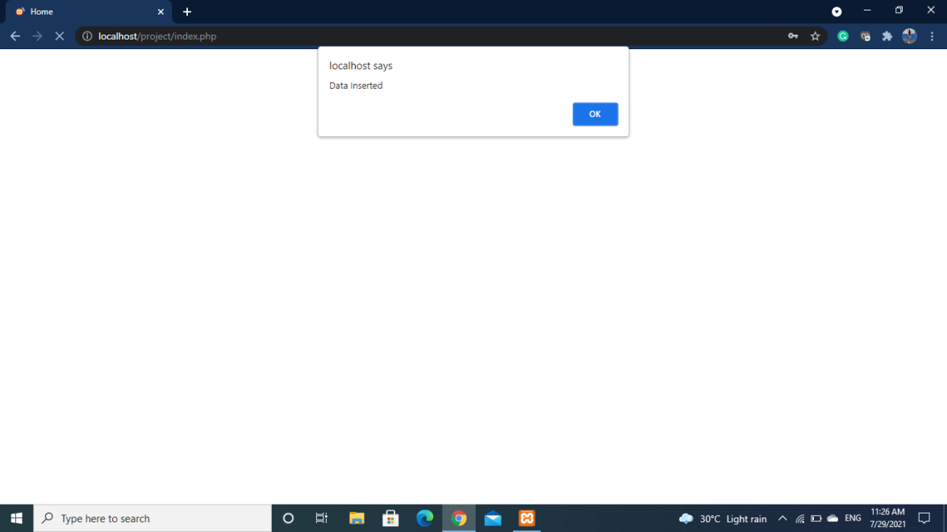
Screenshots

Slide 8
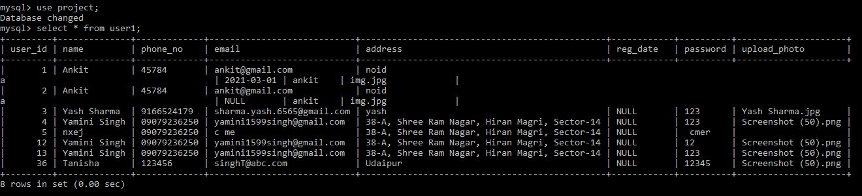
Screenshots

Slide 9
THANK YOU

